Slide 1
Growth of bacteria
Dr. Sahar Mahdi

Slide 2
Growth of bacteria
Growth: means an increase in size, number weigh and mass
Reproduction : an increase in individual number
Cell growth : is a group of reactions and events lead to an increase the macromolecules number and then cell division and reproduction.
The method of division of most bacteria by “binary fission” a new cell grows until it doubles its size when it divides into two halves

Slide 3
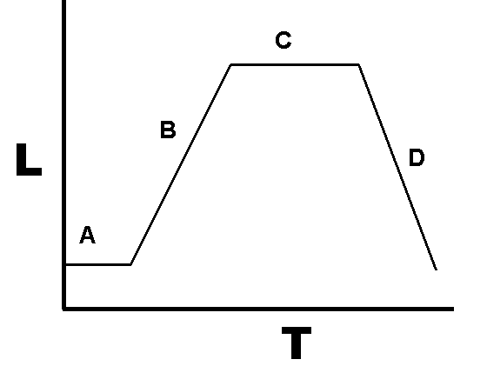
Growth is shown as L = log(numbers) where numbers is the number of colony forming units per ml, versus T (time.)

Slide 4
Doubling time (generation time )
Mean the time required for cells in a microbial population to grow , divide and produce two new cells.
Generation time depend on
1- species of microorganism
2- nutrients
3- Environmental condition (pH, Temp. etc)
4- Growth phase.

Slide 5
A low value of doubling time indicates rapid growth, but a high value indicates slow growth. For this reason growth rate (doubling times per hour) is often used to describe how fast a culture is growing.
The growth rate of the E.coli (10 minutes) but M.tuberculosis (12-15 min.).
There are four main phases of growth :
1- lag phase.
2- exponential phase (log phase).
3- Stationary phase
4- decline (death) phase

Slide 6
When a small number of cells from a pure cultures are inoculated into a liquid medium (broth) , the cells exhibit a characteristic growth curve that can be thought of in four phases.
1- During the lag phase cells are shifting their metabolism to grow on the new medium.
There are two important characteristics of a lag phase:
A- cells are rapidly making new DNA and RNA.
B- inducing the synthesis of new enzymes needed for cell division , and thus there is a great deal of metabolic activity (including synthesis) taking place, but there is no increase in cell numbers.

Slide 7
The length of lag phase depend on:
the condition of M.O.
The nature of media , that mean the phase may long if the inoculum is from an old culture or if the culture is refrigerated .

Slide 8
2- during the log growth phase
Cell division occurs at a maximum rate the growth conditions provided by the medium and those environmental conditions. This is called the exponential phase (log phase), because cell numbers are increasing (doubling) at exponential rate . In other words, the logarithm of the cell number increase linearly with time.

Slide 9
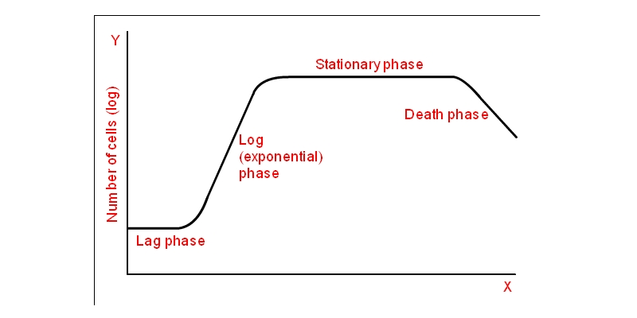
Different phases of growth of a bacteria
Time (hr)

Slide 10
3- stationary phase
There is no net increase or decrease in cells numbers depends on the bacterial type.
Some bacteria stop growing but full maintain their viability.
Others reach a state in which the rate of new cell formation is equal to the rate cell death.
Food begins turn out, poisonous waste products accumulate, pH changes, the rate of fission begins to decline and the organisms die in increasing number.

Slide 11
4- Death (decline) phase
Eventually the number of viable bacterial cells begins to decline.
In some cases death is accompanied by cell lysis, leading a decrease in the direct microscopic count.

Slide 12
Continuous culture
A “continuous culture” is an open system in which fresh media is continuously added to the culture at a constant rate , and old broth is removed at the same rate.
This method is accomplished in a device called a chemostat.
Typically, the concentration of cells will reach an equilibrium level that remains constant as long as the nutrient feed is maintained.

Slide 13
The continuous culture is being used for both research and industrial purpose
The two conditions must be fulfilled:
1- Suitable nutrients must be supplied.
2- the physical conditions must be as near optimum as possible for the organism under consideration

Slide 14
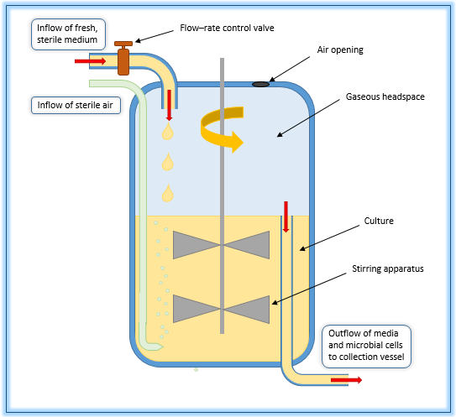
Enclosed chemostat vessel with a continuous and adjustable inflow of medium and outflow of effluent, used for controlled growth of microorganisms. The system maintains a constant volume and level of aeration. The growth rate of the microorganism is controlled by manipulation of the inflow of fresh medium, while the population density is regulated through changing the concentration of the limiting nutrient. This open system allows researchers to maintain the exponential growth phase of cells for use in physiological experiments.

Slide 15
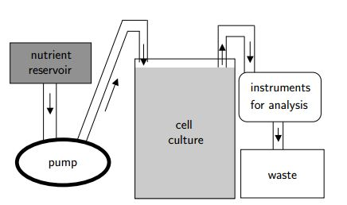
The continuous-flow culture vessel or chemostat.

Slide 16
Nutrient transport processes
Simple Diffusion:
Movement of substances directly across a phospholipids bilayer , with no need for a transport protein.
Movement from high low concentration
No energy expenditure ( e.g ATP) from cell.
Small uncharged molecule may be transported via this process e.g H2O, O2 and CO2.

Slide 17
Facilitated Diffusion:
Movement of substances across a membrane with the assistance of a transport protein.
Movement from high low concentration .
NO energy expenditure (e.g. ATP) from cell.
Two mechanism:
Channel and Carrier Proteins.

Slide 18
:Active Transport
Movement of substances across a membrane with the assistance of a transport protein
Movement from low high concentration
Energy expenditure ( e.g ATP or ion gradients ) from cell.
Active transport pumps are usually carrier protein.

